Slide 1

SENTIMENT ANALYSIS OF TWEET DATA USING NAIVE BAYS AND LAXICON BASED ANALYSIS
Presented By:
Supervised By:
Md. Delwar Hossain
ID:CSE201702103
PMSCS 14th Batch
Jahanginagar University
Sanjit Kumar Saha
Assistant Professor
Dept. of CSE
Jahanginagar University
Friday 13 July 2018

Slide 2
Table of Contents
Abstract
Introduction
Literature Review
Proposed Research
Results & Discussion
Conclusion & Future Scope
Final Thesis

Slide 3
Abstract
This project is on “AN STUDY OF SENTIMENT ANALYSIS OF TWEET DATA USING NAIVE BAYS AND LAXICON BASED ANALYSIS”. It is a sentiment analysis project based on big data analytics. Using simple user interface, they will be able to create a report based on their search keyword. This application is very simple and easy to use. So, it will be comfortable for everyone to use it. To develop this project, need to know R language and platform and its library. To create the user interface using shiny, which is a package including PHP and HTML to create a web application. By giving input inside the shiny app and in the background, R will do the data collection, analysis and output generation. Then shiny will print the output in the web application. Its main task is running the application on the browser, which is taking input and providing us output based on input.
Final Thesis

Slide 4
Introduction
Sentiment analysis is the analysis of human sentiment.
Sentiment can be analyzed form text, image, audio etc.
Sentiment analysis is a part of data mining.
Final Thesis

Slide 5
Introduction Continue
Objectives:-
To study Big Data & Data Analytics.
To study sentiment analysis.
To develop and seek Knowledge on how to deal with tweet data.
To develop Computational tool for sentiment analysis.
To apply the knowledge of sentiment analysis on the real life example.
To build an app for non-technical users.
Final Thesis

Slide 6
Introduction Continue
Try to develop a application for sentiment analysis.
I use R platform and language.
R have strong libraries and user friendly interface.
Data mining using R is very popular now a days.
Final Thesis

Slide 7
Introduction continue
My application will work on a web browser as a web application.
It will take input from the application.
Analysis will happen in the background R platform.
When analysis is done, output will be submitted in the web application.
Final Thesis

Slide 8
Motivation
The explosive growth of the textual information on the web in the past few decades has brought radical change in human life. In the web, people share their opinions and sentiments. So using data mining and sentiment analysis became important for business and data science.
Final Thesis

Slide 9
Motivation Continue
Now a days twitter is a very popular social website were from all over the world people connect with each other and communicate and express their thought through texts. By analyzing their tweets we can decide whatever their mental situation is going on. So we were motivated to analyze tweet data from this thinking.
Final Thesis

Slide 10
Literature Review
Sentiment analysis is the process of computationally identifying and categorizing opinions expressed in a piece of text, in order to determine whether the writer's attitude towards a particular topic, product, etc. is positive, negative, or neutral. I also can define it as opinion mining.
Final Thesis

Slide 11
Literature Review Continue
Sentiment analysis is just not a feature in a social analytics tool – it’s a field of study. This field is still being studied. The accuracy of the analysis is not that much satisficed due to its complex analysis. Because some text mean something else then it is written.
Final Thesis

Slide 12
Literature Review Continue
Existing approaches to sentiment analysis can be grouped into three main categories:
Knowledge-based techniques,
Statistical methods and
Hybrid approaches.
Final Thesis

Slide 13
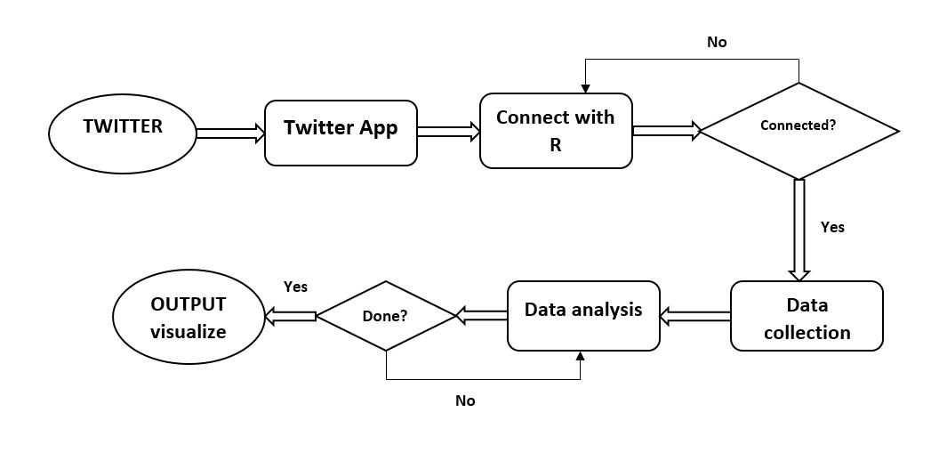
Flow Model
Figure. Data Flow
Final Thesis

Slide 14
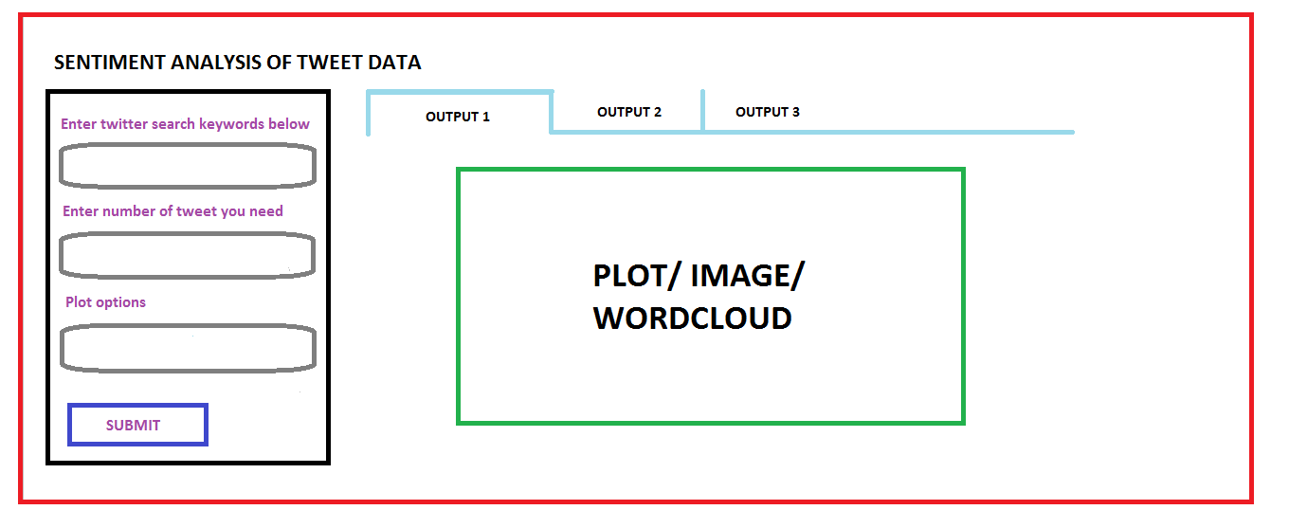
Experimental Layout
Figure. Experimental Layout
Final Thesis

Slide 15
System Requirements, Libraries & Languages Used
Windows
R-Language & Platform
Installed R- Packages
Web Browser
Twitter API
Final Thesis

Slide 16
Implementation
Twitter API: In the implementation part, first of all I create a twitter application. This app is need for connecting R with twitter. For that twitter API gives me some key and tokens.
Final Thesis

Slide 17
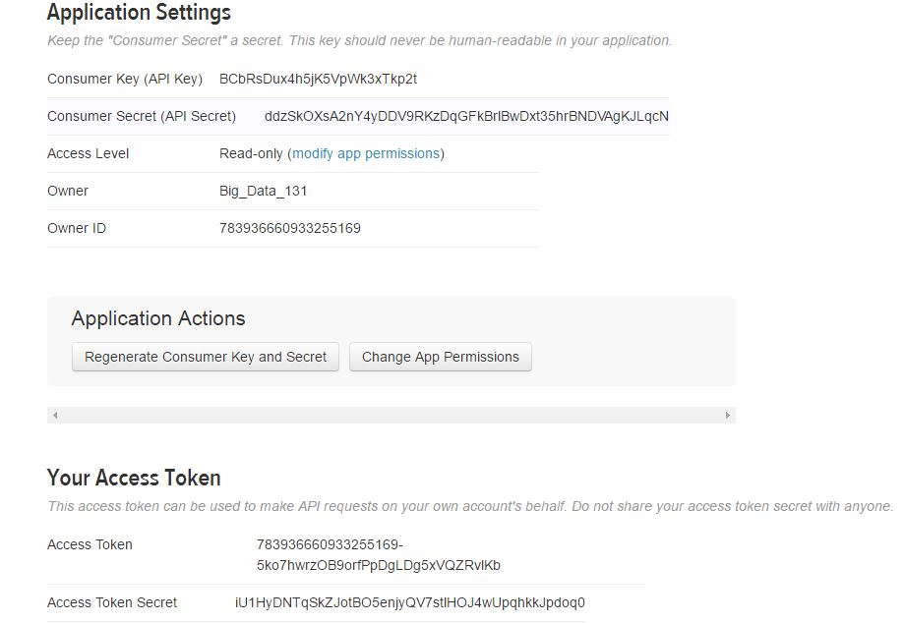
Implementation Continue
Figure. Twitter Application
Final Thesis

Slide 18
Implementation Continue
R script: I write a R script to collect data and analyze them.
Final Thesis

Slide 19
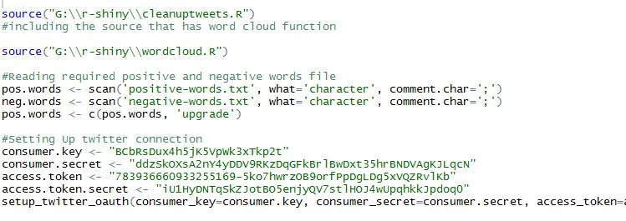
Implementation Continue
Figure. Collect Data and Analyze Code
Final Thesis

Slide 20
Implementation Continue
Web app: To create a user interface I create a web application using shiny, which is a twitter library. It will take input and provide output for the analysis.
Final Thesis

Slide 21
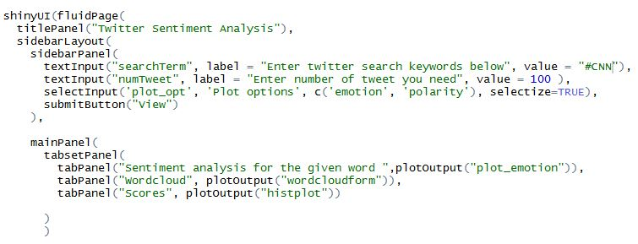
Implementation Continue
Figure. Web Application Code
Final Thesis

Slide 22
Applications
This application can be used for different platforms, as
Product review
Market analysis
Sentimental condition
Data analysis
Research, etc.
Final Thesis

Slide 23
Result
After completing all the coding and necessary analysis I will get 4 types of result as output.
They are:
  Emotions,
  Polarity
  Word cloud,
  Scores.
Final Thesis

Slide 24
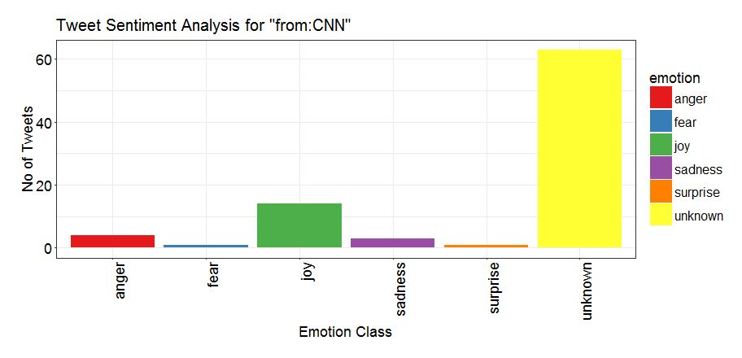
Graphical Representation
Emotion
Figure. Emotion Class
Final Thesis

Slide 25
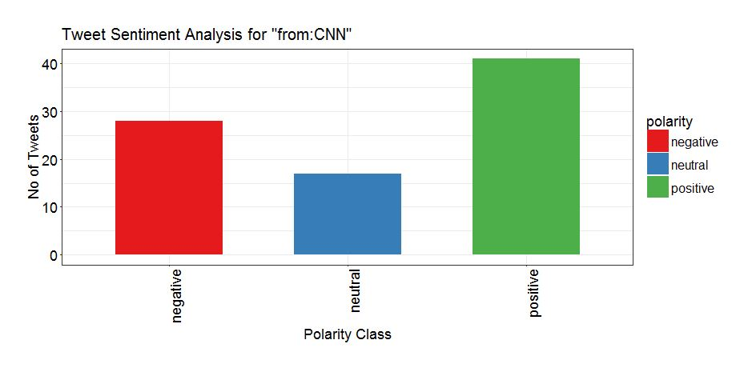
Graphical Representation
Polarity
Figure. Polarity Class
Final Thesis

Slide 26
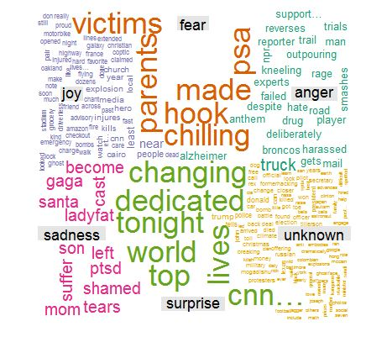
Graphical Representation
Word cloud
Figure. Word Cloud
Final Thesis

Slide 27
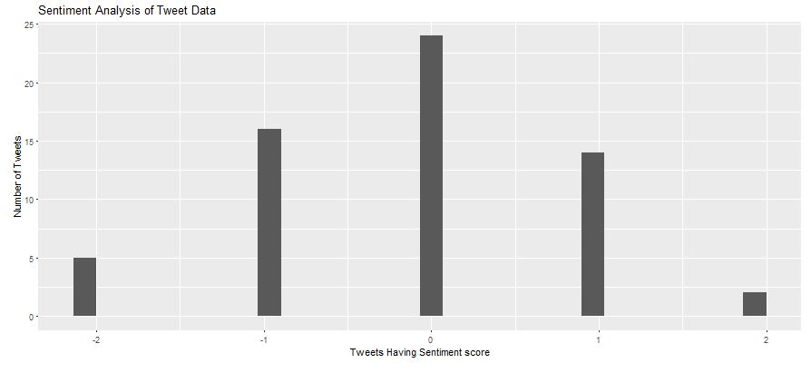
Graphical Representation
Scores
Figure. Scores Histogram
Final Thesis

Slide 28
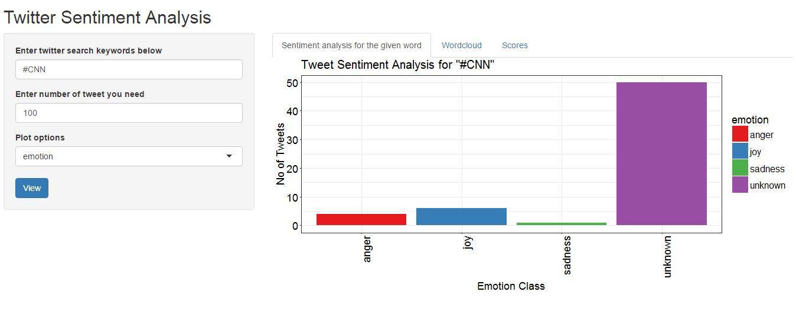
Finalizing the Result & Output
Figure. Searching For Tweets and Output
Final Thesis

Slide 29
Conclusion
Conclusion:-
I try to develop a complete project on sentiment analysis of tweet data. Doing project faces many challenges and end of the day I finished my work. I able to collect tweet data and analyze them using R-platform & R-language. I present analysis result based on polarity and emotion’s.
Final Thesis

Slide 30
Future Work
Future work for this project are:
Development of the algorithms
Data Analysis in Bangla
Final Thesis

Slide 31
Reference
https://en.wikipedia.org/wiki/Sentiment_analysis
https://www.quora.com/What-are-the-applications-of-sentiment-analysis- Why-is-it-in-so-much-discussion-and-demand
http://www.adweek.com/prnewser/5-key-challenges-in-sentiment-analysis/116604
http://www.sciencedirect.com/science/article/pii/S1018363916300071
LEKHA R. NAIR, DR. SUJALA D. SHETTY, STREAMING TWITTER DATA ANALYSIS USING SPARK FOR EFFECTIVE JOB SEARCH, Journal of Theoretical and Applied Information Technology, 20th October 2015. Vol.80. No.2.
Vishal A. Kharde, S.S. Sonawane, Sentiment Analysis of Twitter Data: A Survey of Techniques, International Journal of Computer Applications (0975 – 8887), Volume 139 – No.11, April 2016.
Final Thesis

Slide 32
THANK YOU
Final Thesis

